Slide 1

Entity-Relationship Model
Presented By:
Elizer Ponio Jr. Department of Computer Science
College of Computing and Information Technologies

Slide 2
Outline
Database Design and Design Phases
What is an Entity Relationship Model?
Components of an ER Diagram
Entities
Attributes
Relationships

Slide 3
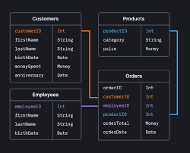


Database Design
The task of creating a database application is a complex one, involving:
The design of the database schema.
Design of the programs that access and update the data.
Design of a security scheme to control access to data.

Slide 4
Database Design Phases
Gather user requirements
Characterize the needs of the prospective users.
Choose data model
Choose data model and translate requirements into a conceptual schema of the database.
Specify the functional requirements
Describe the kinds of operations (that will be performed on the data.
Interact domain experts and users to
Operations include modifying or updating data, searching for and retrieving specific data, and deleting data
Implement model
Logical Design Phase - Map the high-level conceptual schema onto the implementation data model of the database system that will be used
Physical Design Phase – Specify physical feature of the databasew

Slide 5

Outline
Database Design and Design Phases
What is an Entity Relationship Model?
Components of an ER Diagram
Entities
Attributes
Relationships

Slide 6


What is an Entity-Relationship Model?
An Entity-Relationship Model represents the structure of the database with the help of a diagram.
ER Modelling is a systematic process to design a database as it would require you to analyze all data requirements before implementing your database.

Slide 7
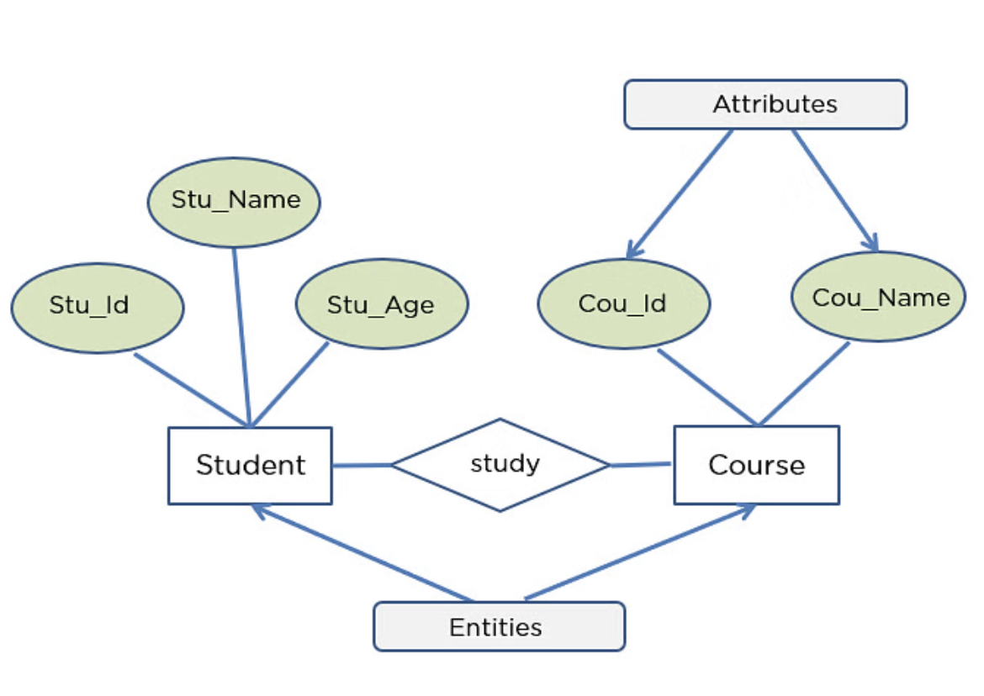
What is an Entity Relationship Diagram?
An Entity-relationship Diagram describes the relationship of entities that need to be stored in a database.
ER Diagram is mainly a structural design for the database. It is a framework using specialized symbols to define the relationship

Slide 8
ER diagram is created based on three main components, entities, attributes, and relationships.

Slide 9
The following diagram showcases two entities - Student and Course, and their relationship, study which describes that a student studies in a course of their choosing.

Slide 10
The relationship described between student and course is many-to-many, as a course can be opted by several students, and a student can opt for more than one course.

Slide 11
Student entity possesses attributes - Stu_Id, Stu_Name & Stu_Age. The course entity has attributes such as Cou_ID & Cou_Name.

Slide 12
Why do we need to use ER diagrams?
ER Diagram helps you conceptualize the database and lets you know which fields need to be embedded for a particular entity.
ER Diagram gives a better understanding of the information to be stored in a database.
It reduces complexity and allows database designers to build databases quickly.
It helps to describe elements using Entity-Relationship models.
It allows users to get a preview of the logical structure of the database.

Slide 13
Symbols used in ER diagrams
Shape | Component | Description
 | Entity | This symbol represent entities
 | Attribute | This symbol represents attributes.
 | Relationship | This symbol represents relationship types
 | Weak Entity | Used for arithmetic operations and data-manipulations.
 | Derived Attribute | Represents derived attributes
 | Multi-valued Attribute | Represents multi-valued attributes

Slide 14
Outline
Database Design and Design Phases
What is an Entity Relationship Model?
Components of an ER Diagram
Entities
Attributes
Relationships

Slide 15
Components of an ER diagram
Component | Types
Entity | Weak Entities
Attribute | Key Attribute Composite Attribute Multivalued Attribute Derived Attribute
Relationship | One-to-One Relationships One-to-Many Relationships Many-to-One Relationships Many-to-Many Relationships

Slide 16
Outline
Database Design and Design Phases
What is an Entity Relationship Model?
Components of an ER Diagram
Entities
Attributes
Relationships

Slide 17
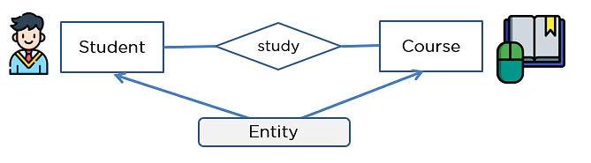
Entities
An entity can be either a living or non-living component.
It showcases an entity as a rectangle in an ER diagram.
For example, both the student and the course are entities.

Slide 18
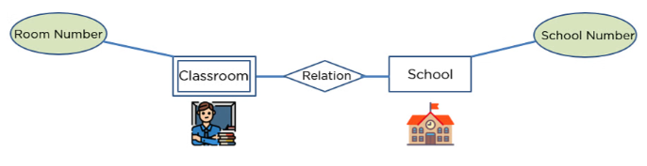
Weak Entities
Weak entities do not have any primary key and they cannot be identified on their own, so their existence depends on some other entity.
It is represented as a double rectangle in ER Diagram
In the example below, the existence of classrooms is entirely dependent on the existence of a hotel. The classroom can be seen as the weak entity of the school.
The school number along with the room number would be used to identify it.

Slide 19
Other examples of weak entities
Employee ID
Employee Name
Company ID
Company Name
Enrolls
Employee
Company
An Employee entity cannot be created if the Company entity does not exist
Company is a strong entity because it has a primary key attribute Company ID which is capable of uniquely identifying all companies.
Unlike Company, Employee is weak entity because it does not have any primary key.
Employee ID along with the Company ID can uniquely identify the records of an employee. So here the Employee ID is the partial key.

Slide 20
Strong Entity vs Weak Entity
Strong Entity | Weak Entity
Strong entity always has a primary key. | It will not have a primary key but it has partial discriminator key.
It is not dependent on any other entity. | Weak entity is dependent on the strong entity.
Represented by a single rectangle. | Represented by double rectangle.

Slide 21
Outline
Database Design and Design Phases
What is an Entity Relationship Model?
Components of an ER Diagram
Entities
Attributes
Relationships

Slide 22
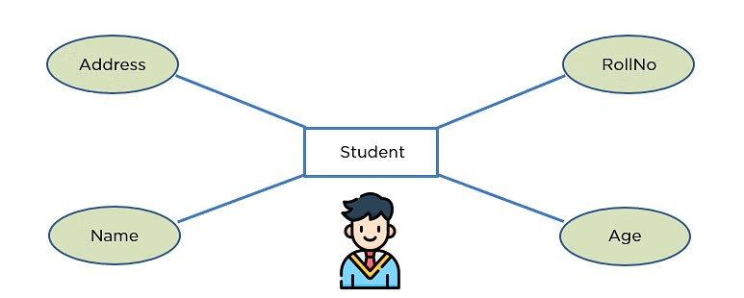
Attribute
An attribute exhibits the properties of an entity.
You can illustrate an attribute with an oval shape in an ER diagram.
It has several types such as Key, Composite, Multivalued and Derived

Slide 23
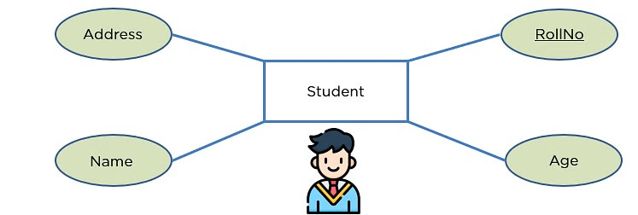
Key Attribute
Key attribute uniquely identifies an entity from an entity set.
It underlines the text of a key attribute.
For example: For a student entity, the roll number can uniquely identify a student from a set of students.

Slide 24
Key Attribute (continued)
An entity set is a collection of entities.
Student ID | Name | Age
1 | Elizer | 33
2 | Alaa | 23
3 | Michael | 23
Each row in the student table is an entity.
Each entity belongs to the student type. Hence the type of entity here is a student.
For this table, all records in this table (students with id 1,2,3) are the entity set.

Slide 25
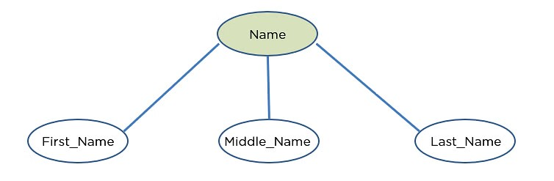
Composite Attribute
An attribute that is composed of several other attributes is known as a composite attribute.
An oval showcases the composite attribute, and the composite attribute oval is further connected with other ovals.

Slide 26
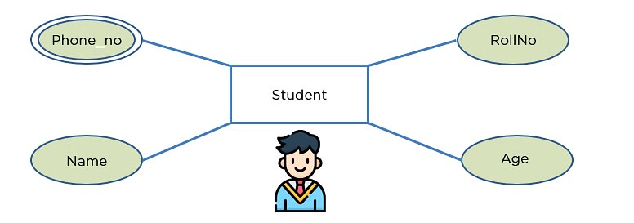
Multivalued Attribute
Some attributes can possess over one value, those attributes are called multivalued attributes.
The double oval shape is used to represent a multivalued attribute.
For example, one student can have two or more phone numbers.

Slide 27
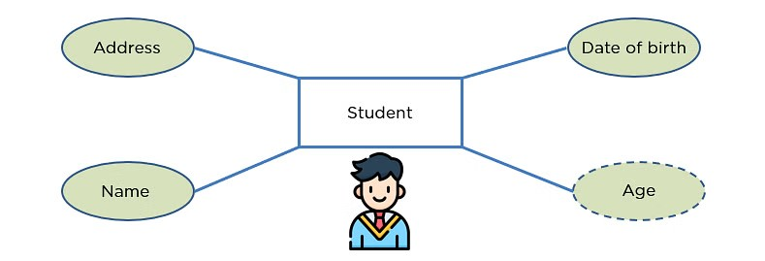
Derived Attribute
An attribute that can be derived from other attributes of the entity is known as a derived attribute.
In the ER diagram, the dashed oval represents the derived attribute.
For example, age can be derived by subtracting the current date and the date of birth.

Slide 28
Outline
Database Design and Design Phases
What is an Entity Relationship Model?
Components of an ER Diagram
Entities
Attributes
Relationships

Slide 29
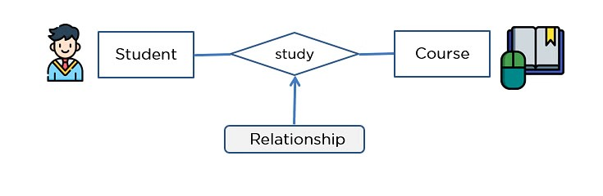
Relationship
It depicts the relationship between two entities.
The diamond shape showcases a relationship in the ER diagram..
In the example below, both the student and the course are entities, and study is the relationship between them.

Slide 30

One-to-One Relationship
When a single element of an entity is associated with a single element of another entity, it is called a one-to-one relationship.
For example, a student has only one identification card and an identification card is given to one person.

Slide 31
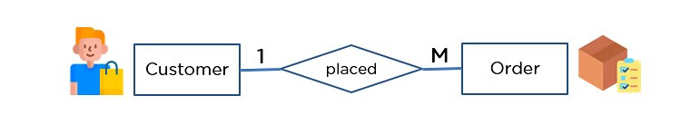
One-to-Many Relationship
When a single element of an entity is associated with more than one element of another entity, it is called a one-to-many relationship.
For example, a customer can place many orders, but an order cannot be placed by many customers.

Slide 32

Many-to-One Relationship
When more than one element of an entity is related to a single element of another entity, then it is called a many-to-one relationship.
For example, students have to opt for a single course, but a course can have many students.

Slide 33

Many-to-Many Relationship
When more than one element of an entity is associated with more than one element of another entity, this is called a many-to-many relationship.
For example, you can assign an employee to many projects and a project can have many employees.

Slide 34
Important points when drawing an ER Diagram
Identify all the entities. Embed all the entities in a rectangle and label them properly.
Identify relationships between entities and connect them using a diamond in the middle, illustrating the relationship. Do not connect relationships with each other.
Connect attributes for entities and label them properly.
Eradicate any redundant entities or relationships.
Make sure your ER Diagram supports all the data provided to design the database.
Effectively use colors to highlight key areas in your diagrams.

